Slide 1

BASIC ELECTRICAL AND ELECTRONICS ENGINEERING
Course Code: CSE1002
SCHOOL OF COMPUTER SCIENCE ENGINEERING AND APPLICATIONS
Mrunmayee Rahate
Assistant Professor, DYPIU

Slide 2
Module 1: Fundamentals of Electrical Circuits
Lecture 7:
Network Theorems: Maximum Power Theorem

Slide 3
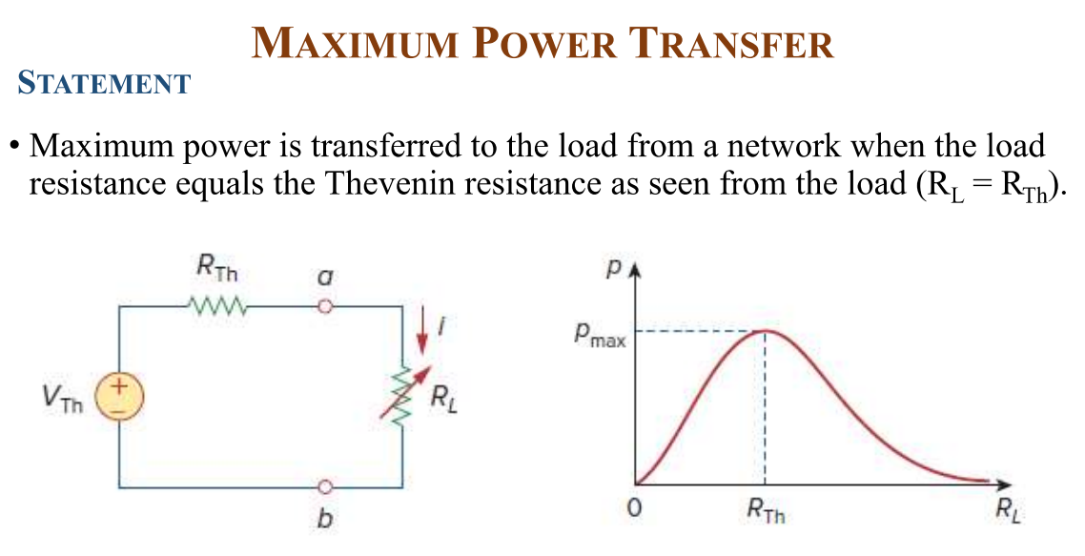

Slide 4
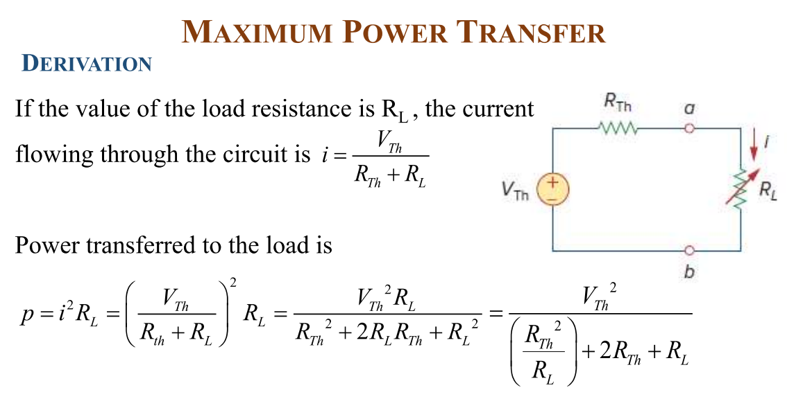

Slide 5
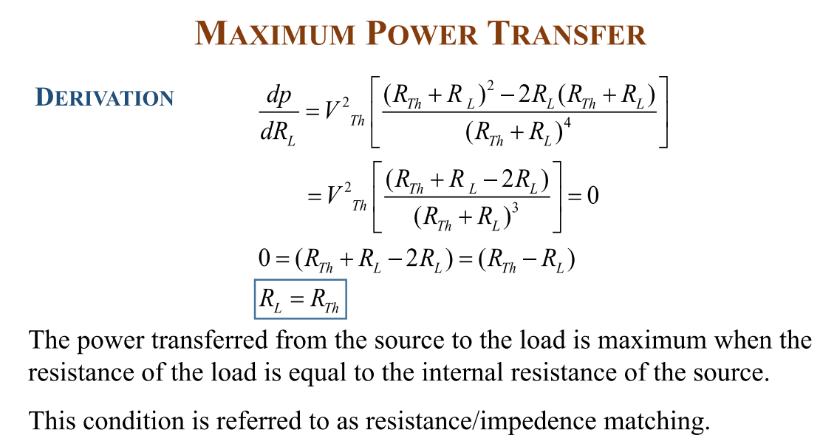

Slide 6
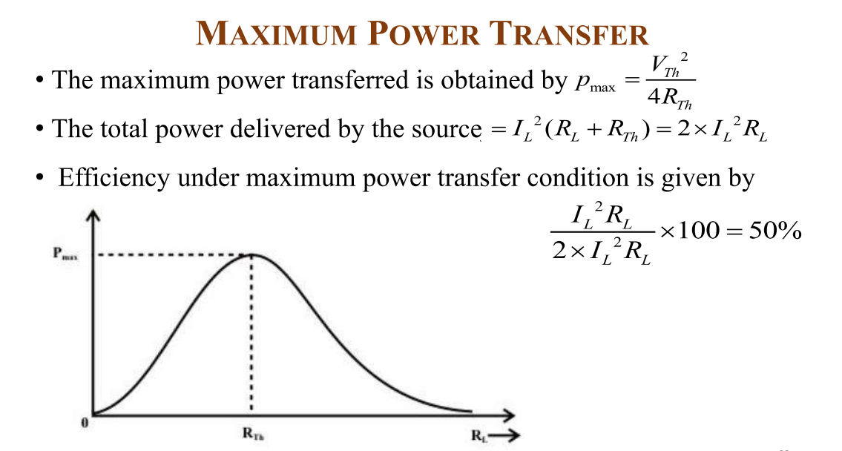

Slide 7
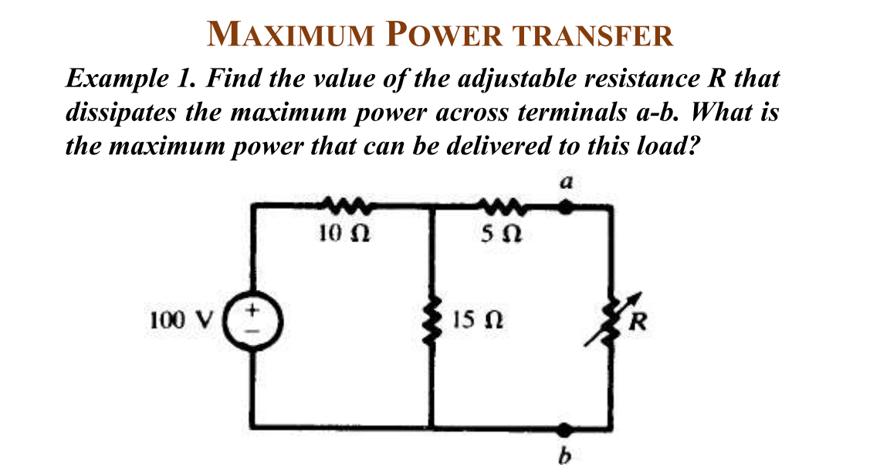

Slide 8
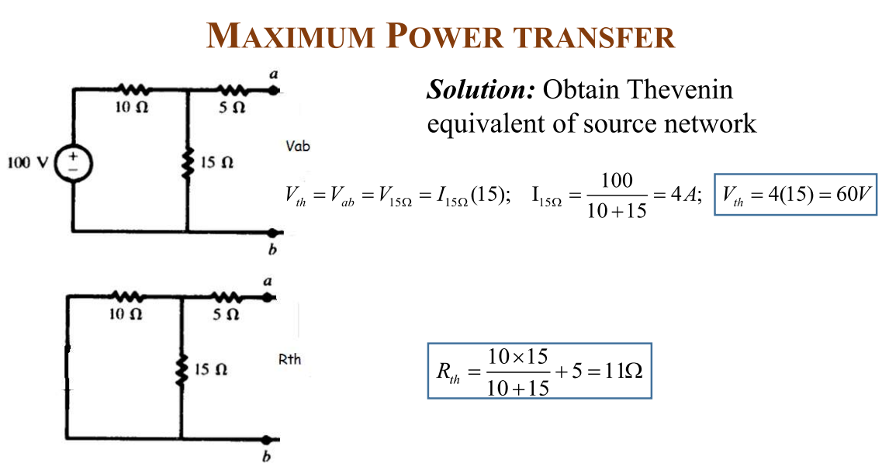
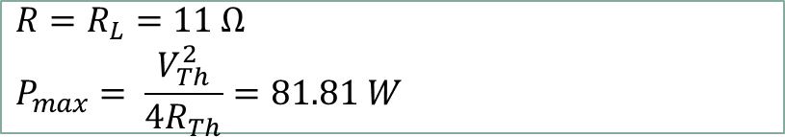
${R=R}_{L}=11 Ω$
$$P_{max}= \frac{V_{Th}^{2}}{4R_{Th}}=81.81 W$$

Slide 9
Thank You !!!

